Slide 1
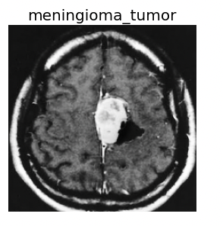
Brain Tumor Classification
Cloud Computing
Fall 2021
Kristin Levine
Mariko McDougall
Joe Valle

Slide 2
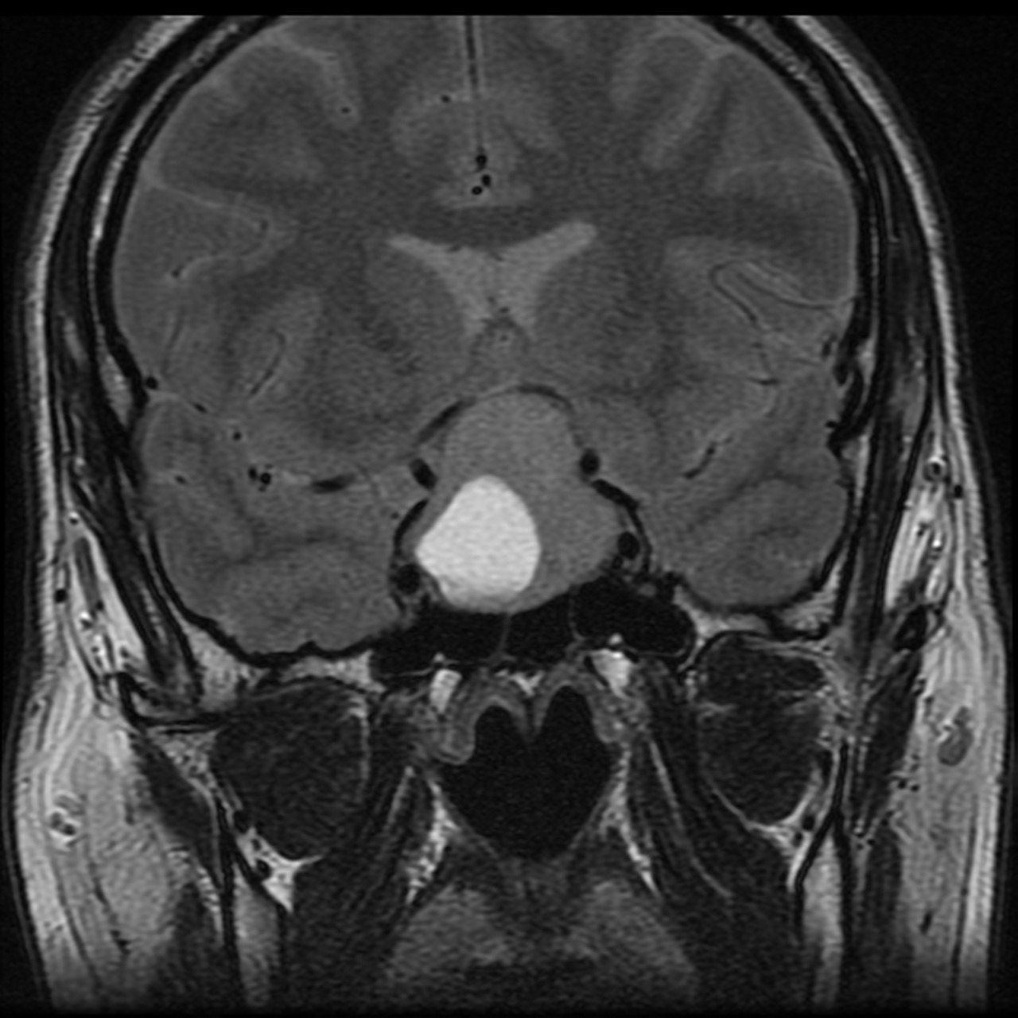
Table of Contents
Definition
Scope
Data sources
Architecture
Architecture description
Applicable cloud services
Data flow
Expected outcomes
Demonstration
Demonstration
Helpful links
Pituitary tumor

Slide 3
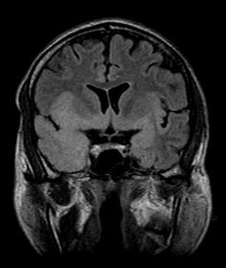
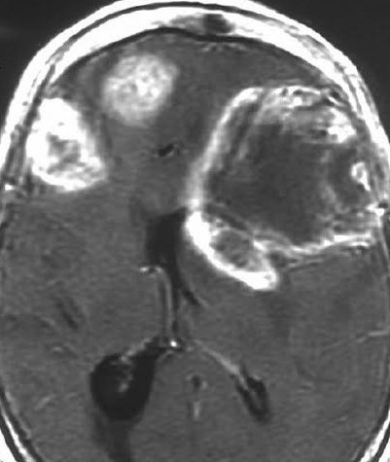
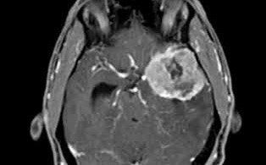
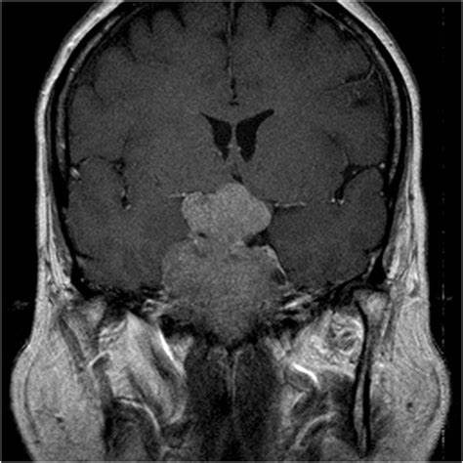
Scope of the Project
Incorporate deep learning on AWS to classify brain MRIs by their clinical diagnosis, and identify their tumors if present
No tumor
Glioma tumor
Meningioma tumor
Pituitary tumor

Slide 4
Data Sources
Data has been downloaded from Kaggle’s Brain Tumor Classification (MRI) dataset
Classes for 3264 MRI jpgs
No tumor
Glioma tumor
Meningioma tumor
Pituitary tumor
Deep learning via three convolutional neural network (CNN) models to correctly classify MRIs
ResNet50
VGG16
Xception
Train and evaluate the models together on Google Colab before working on AWS
Combine these together under a random forest model

Slide 5
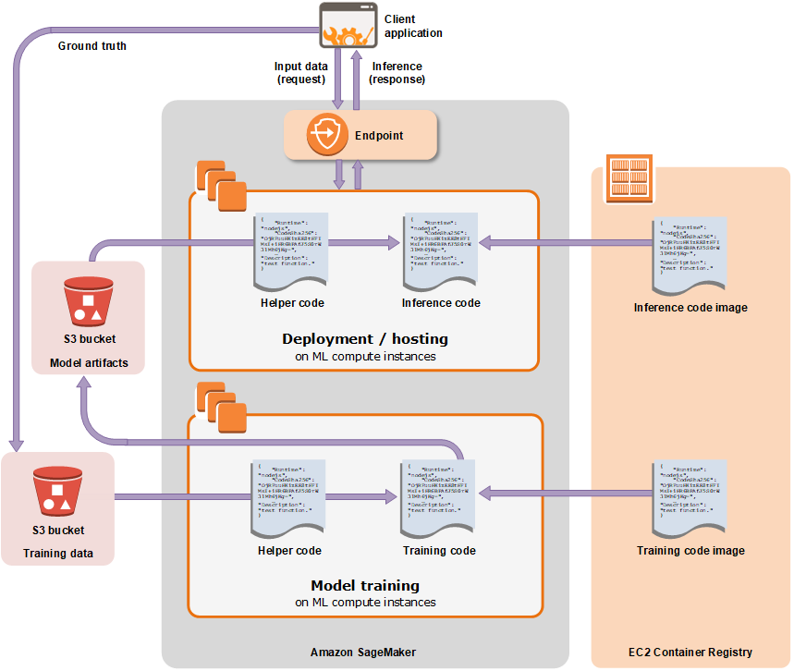
Project Architecture
Train three CNN models locally
ResNet50
VGG16
Xception
Extract and train these models together locally in a new file
Random forest
Store the images and models separately from each other
Deploy the models together on AWS
Image source: Amazon SageMaker Developer Guide

Slide 6
Project Architecture (Continued)
Non-AWS
Download training images
Download testing images
Public AWS access
Train models on Google Colab
Save testing images in S3 bucket
Launch SageMaker instance
Deploy models
Save trained models in S3 bucket
View output on website
Create user identity pool with Cognito
Private AWS access

Slide 7
Applicable Cloud Services and Data Flow
Data storage with S3
Hold images and models in separate buckets
Allow images to be distinguished by class
Incorporate testing, not training, images
Deep learning with SageMaker
Initiate Jupyter Notebook instance on the cloud
Extract data from the buckets for testing
Deploy the model and evaluate its accuracy
Can work on a locally trained model to reduce costs
User access with Cognito
Create an identity pool to allow unauthenticated users to view images
Compare four patients’ diagnoses side by side for accuracy

Slide 8
Expected Outcomes
User can upload any MRI to the image bucket on S3
Image class itself represents the output
Bucket can be stored as private to limit public access
Local CNN models can be transferred successfully to AWS
Reduces costs by relying on Google Colab rather than SageMaker for early training
Key figures to evaluate from SageMaker
F-score
Precision
Recall
Individual patient pie charts to analyze the model’s accuracy and deployment
Compare the number of correctly identified MRIs with their predicted classes

Slide 9
Demonstration
Demonstration link:
http://medical-images-testing.s3-website-us-east-1.amazonaws.com/
GitHub link:
https://github.com/m-mcdougall/Sagemaker_Tumor_Classifier_DATS6450

Slide 10
Helpful Links and References
Deploying Locally Trained Model to SageMaker:
https://medium.com/geekculture/84af8989d065
SageMaker Developer Guide:
https://aws.amazon.com/blogs/aws/sagemaker/
Reading Data Files on S3 from SageMaker:
https://towardsdatascience.com/how-to-read-data-files-on-s3-from-amazon-sagemaker-f288850bfe8f
SageMaker Developer Resources:
https://aws.amazon.com/sagemaker/developer-resources/?ar-cards-sagemaker.sort-by=item.additionalFields.datePublished&ar-cards-sagemaker.sort-order=desc
Saving and Loading Random Forest:
https://mljar.com/blog/save-load-random-forest/
Viewing S3 Images in Browser:
https://docs.aws.amazon.com/sdk-for-javascript/v2/developer-guide/s3-example-photos-view.html

